Slide 1


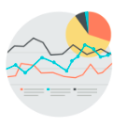





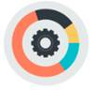

Service Offerings
Application Development
Enterprise Performance Management
Application Development, Maintenance and Support
Agile Product Development
Release Management Services
Strategy and Implementations
planning, Forecasting and Financial Consolidations Probability and Cost Management
Big Data Analytics
Enterprise Resource planning
Advanced Analytics – Predictive, Prescriptive,
Descriptive and Diagnostic
Statistical and Mathematical Data Analysis
Business Intelligence Modernization
Full Implementations
Data Quality & Conversions
Testing Automations and Support Services
Customer Relationship Management
IT Infrastructure Management
Sales Management
Customer Support and Services
Marketing Automation and EDM
Unified Computing System Management
Hyper Visor/Network/Server/Storage Management
Cloud Services Management
Digital
Engineering Services
Experience Design, IoT, Portals & Content Management, Social, Mobile, Insights and
E-commerce
Network planning & designing
Network migration support
ISP designs, Asset management
Enterprise Information Management
Validation Services
Enterprise Integration (Extract, Transform, Load)
Master Data Management
Data Governance
Independent Testing Services
Testing Automation
Test CoE
Notes:
We innovated ourselves with our services, specific products in certain areas. We continuously expand by investment in associates, skills and right opportunities.
We are not just an ERP company/provider. Our deep expertise in focused areas added value through SAP HANA, BPC, Infrastructure management, Big data, Analytics. We innovate in these areas by organic and inorganic way.
Application development – also includes Application transformation, Technology- .Net, Java
Big Data Analytics – BI Mordenization - Hadoop Infra/ Data Lake

Slide 2
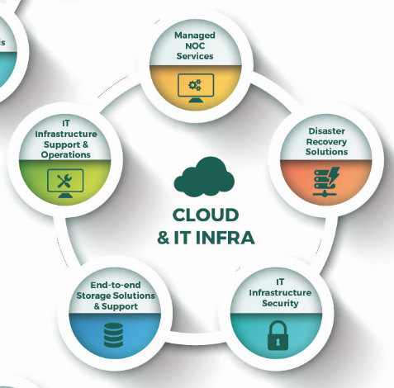
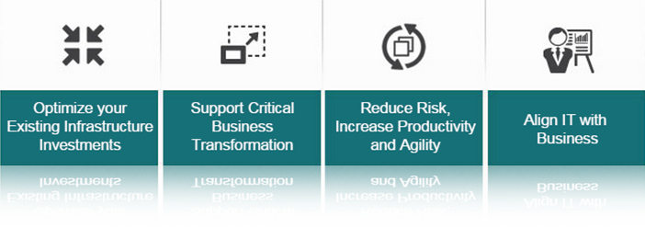
On Cloud, RIMS and DevOps
Our objectives
Techwave’s Technical Expert partnership and Consulting-led approach with key capabilities in Data Center, Remote Infrastructure, Cloud Management and DevOps will create greater value for your business. While our Focus is on Consolidating, Integrating, Virtualizing, Optimizing and Automating your IT Systems, however, we Align and give at par importance to transform IT as an Enabler of your Business through a Digital Transformation Framework by leveraging our expertise to Enhance, Extend and Re-define Value Proposition & SLA driven Delivery.
Our Robust model, Standardized Tools and proven Processes enable Enterprises to achieve cost efficiency and accelerated time-to-delivery. Our IT security services are aimed at ensuring integrity and compliance through industry standards such as ITIL, ISO 27001, CMMi and ISO 9001.

Slide 3
Practice Portfolio IMS
Key Offerings
Support for a wide range of technologies in the enterprise IT environment — from on premise to cloud — servers, networks, storage, applications, virtualization, unified communication, VOIP, Telco, desktops, mobility, data center, distributed computing, middleware, database, platforms, as well as cloud technologies such as public cloud, private cloud, and converged infrastructure
RIMS
Cloud environments setup/Cloud application migration – automate new environment creation and deploy applications/Cloud optimization services – cost and performance optimization/Cloud infrastructure security and Business continuity using cloud
CLOUD
IMS
Tightly align development, QA, and operations teams on agile DevOps processes including automation, collaboration, continuous integration (CI), continuous delivery (CD), source code management, change management, infrastructure-as-code, and production support processes
DEV OPS

Slide 4
Practice Portfolio IMS
Key Solutions
Value Proposition
Robust service offering covering Cloud, Infra, open source and Dev Ops
Effective managed services
Client specific support model
25-30%+ cost savings in IT operations
90-95%+ attainment on first-to-know and first-to-report
40-65%+ reduction in MTTR
30-50%+ reduction in tools cost
30-40%+ of L3 resources shifted from reactive tasks to revenue driven initiatives
50-60%+ runbooks automated
Implement service catalog & chargeback for operations
Reporting & visibility at BU, group, and site level
IMS
Monitor Infra
ServInfra
ServNet
ServStor
IT Monitoring
&
Event Management
Solution
Enterprise
Server
Management
Solution
Enterprise
Network
Management
Solution
Enterprise
Storage
Management
Solution

Slide 5
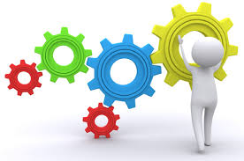
Value Add
Organization wise
Large Organizations :
Infrastructure Optimization and Automation
Service Optimization and Automation
Resource Optimization
Streamlining the single point of failures
Progress towards Hybrid Cloud Architecture
Medium Organizations :
Replacing appropriate OEM Tools with Open Source
Run Books, SOPs and Work Instructions
DR/Backup Optimization
Infrastructure and Service Optimization
Automation
Small/Startup Organizations:
Provide Platform based System Services
Complete Subscription/Opex based services
Bundled Support and Managed Services
DevOps Services
Archived/Object Storage Services

Slide 6
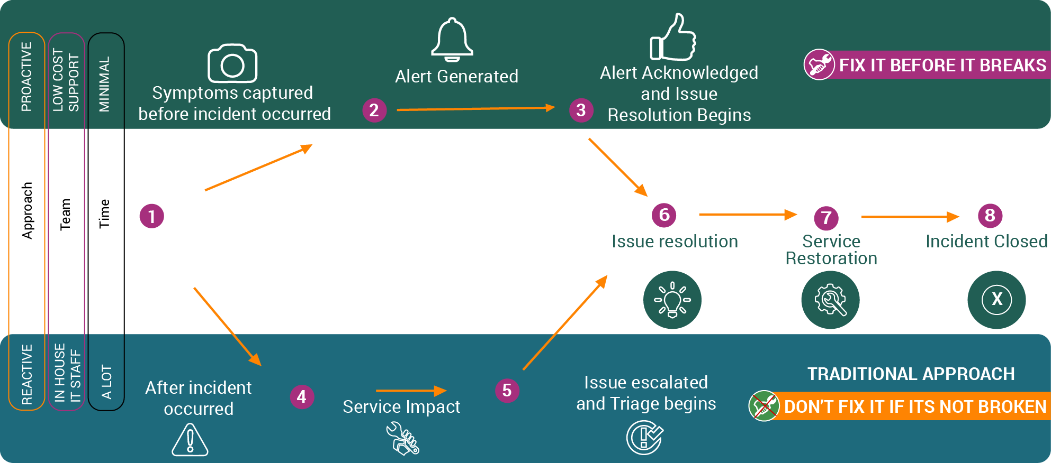

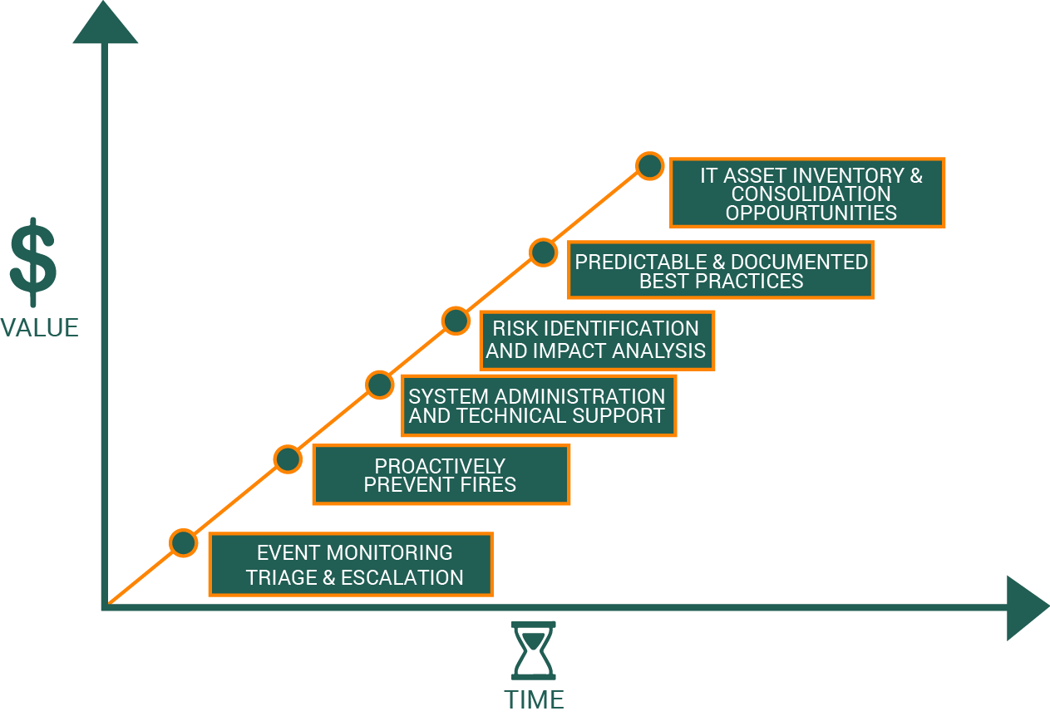
MonitorInfra
Proactive Monitoring & Event Management from NOC
MonitorInfra:
Proactive Health Monitoring 24 x 7 x 365
Parametric & Threshold Based
Capacity & Utilization Check
Max.Uptime and Availability
Possible issues – Service Age
Event Log Analysis
Event Management
Incident Management
IT Operations Management
Tools:
Service Management
Alert Management
Operational Intelligence

Slide 7
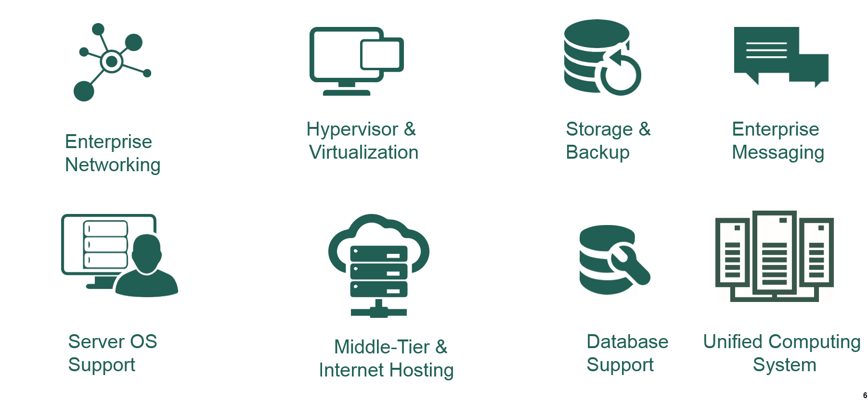
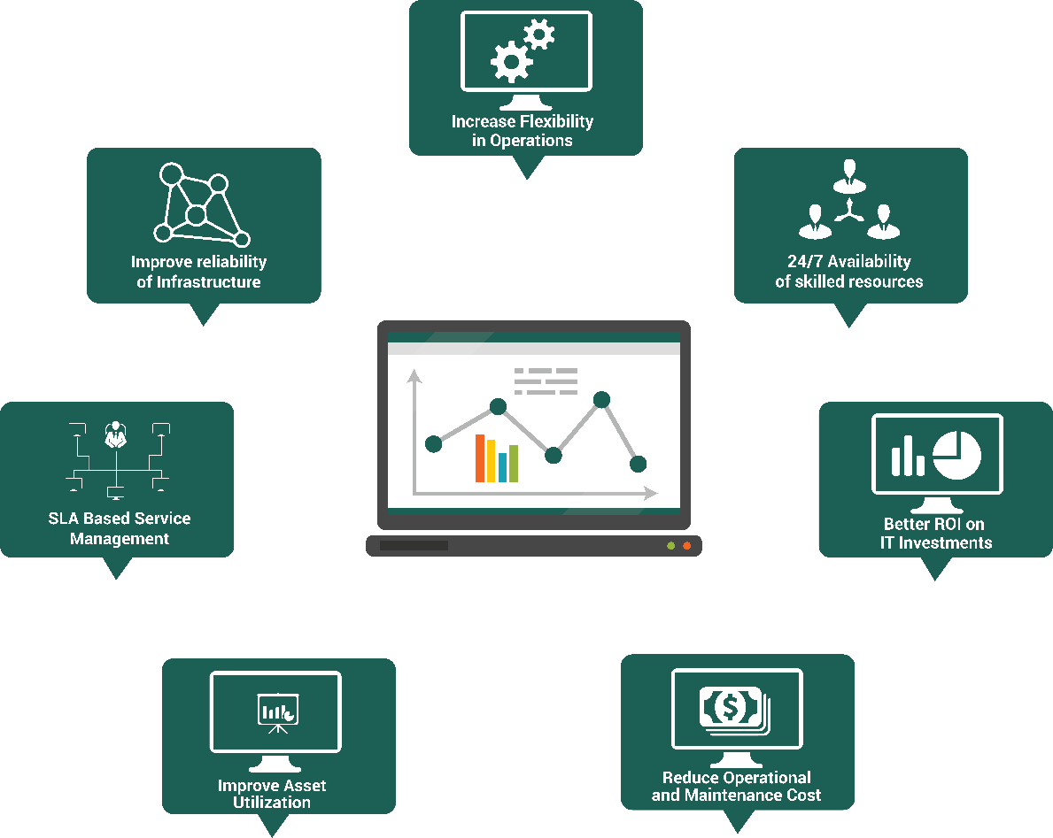
ServInfra
IT Infrastructure Support & Operations
ServInfra:
IT Infrastructure Support covering Design, Build, Deploy, Customize and Operate
Migration and Upgradation Support
CoE based support for :
Tools:
Agent/SNMP based Infra Management
Centralized Dashboards
Operational Intelligence

Slide 8
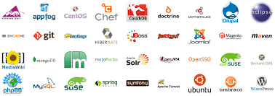
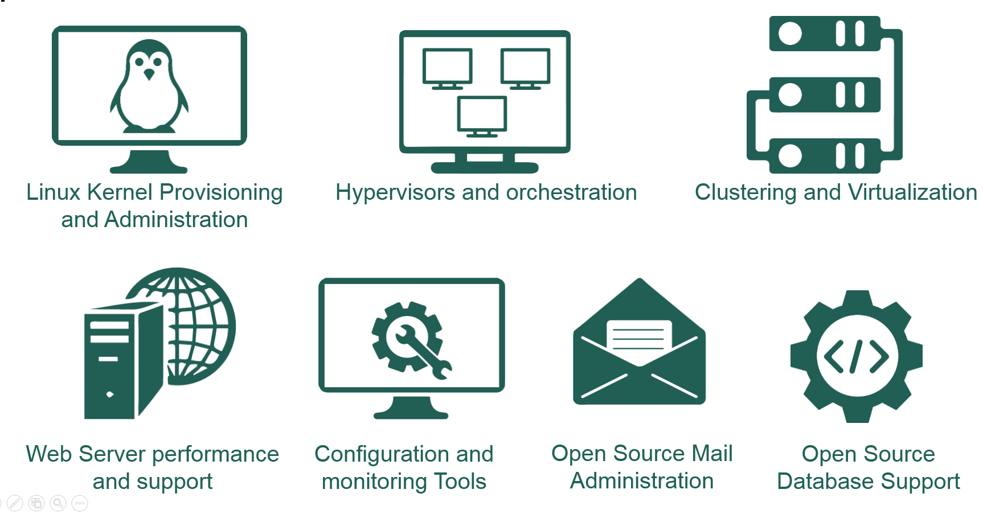
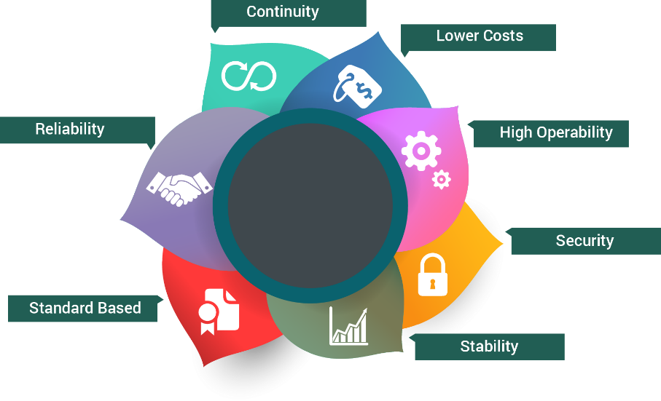
ServOpen
Dedicated Support for Open Source Systems
One stop support solution for Open source systems
Covering Design, Build, Deploy, Customize, Operate, Migrate and Upgradation of Open source systems
CoE based support :

Slide 9
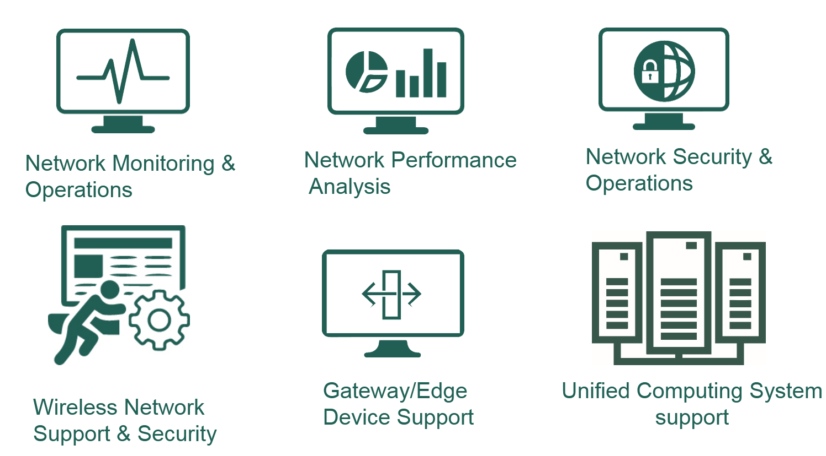
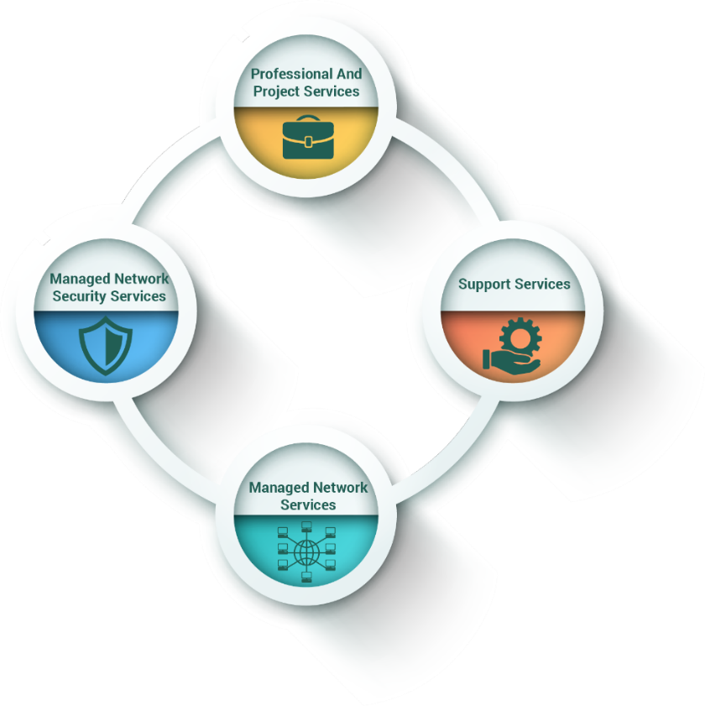
ServNet
Dedicated Support for Enterprise Networking
ServNet:
Enterprise Network support covering the design, deployment, strengthening, security and operations
CoE based support for :
Value & Benefits
Maximize Uptime
Improve Network Performance
Network Protection
Low Latency & Congestion
Complete Control on Infra

Slide 10


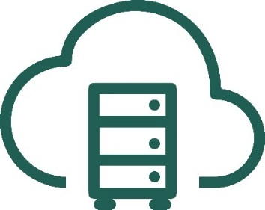
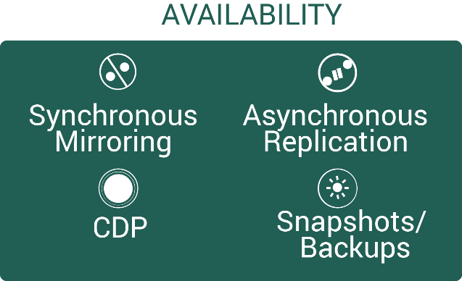
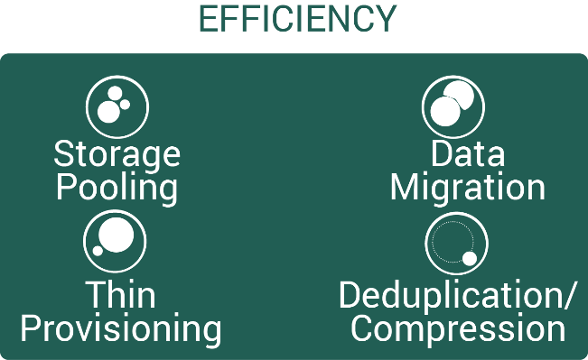
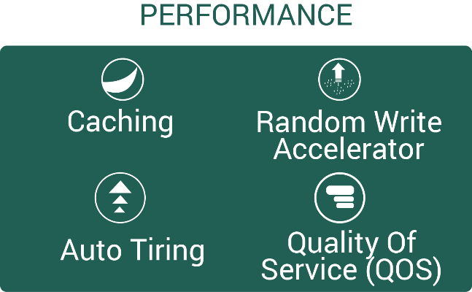
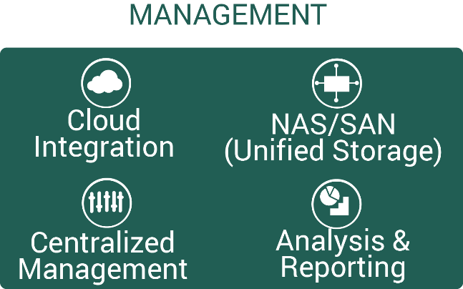
ServStor
End to End Storage Solutions and Support
CoE based support :
Netapp/EMC/IBM/Fujitsu/Hitachi/HP Storage Administration
Nimble Storage Administration
Cloud Storage Administration
Storage Monitoring and Operations
ServStor:
Storage Designing, Implementation, Virtualization, Security, Migration, Load Balancing and Support
Storage Work Flow Automation, Performance Tuning
Storage
Administration
Storage Monitoring
and Operations
Cloud Storage
Administration

Slide 11
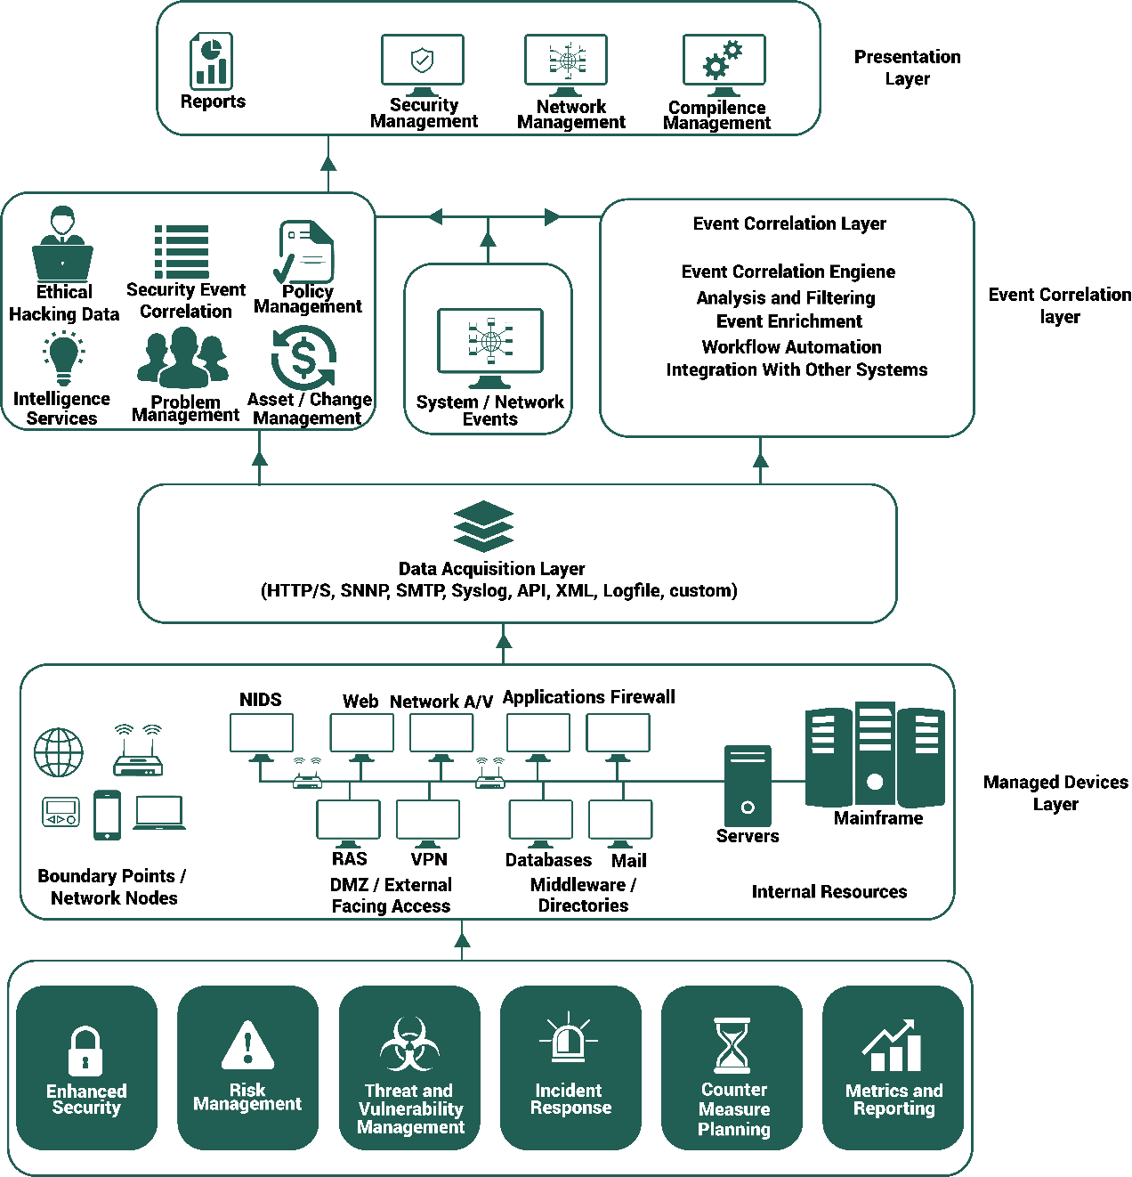
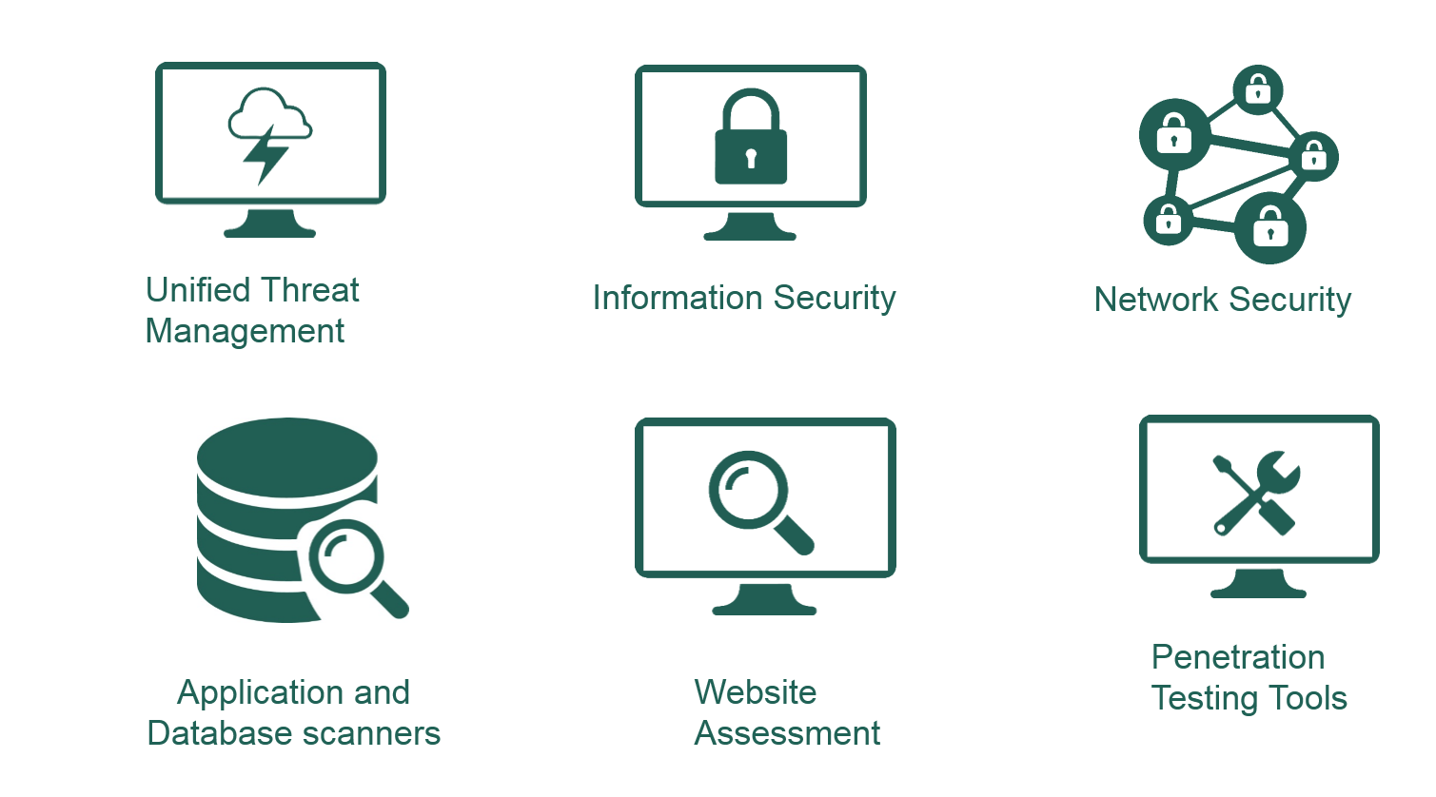
SecureIT
IT Infrastructure Security from SOC
SecureIT:
Complete Security Solution for IT Infrastructure
Process driven real time monitoring and management
Dedicated support from SOC

Slide 12

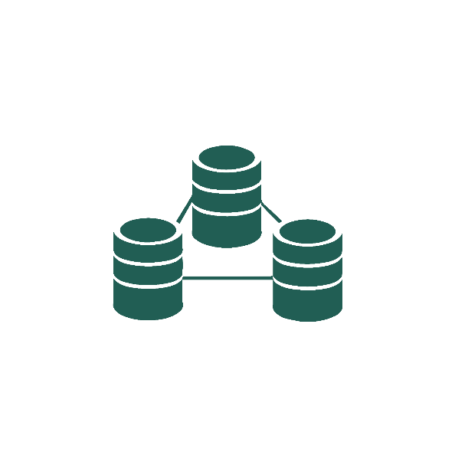





ServDB
Dedicated Support for Database Administration
ServDB:
Complete support solution for Database Administration
Platform based solutions and support
Clustering and HPC Environment support
CoE based support for :
Oracle
DB2
SQL Server
MySQL
Non-Sql DBs
Design
Implementation
Database
Administration
Clustering
Performance Tuning
Problem Solving
Validation

Slide 13
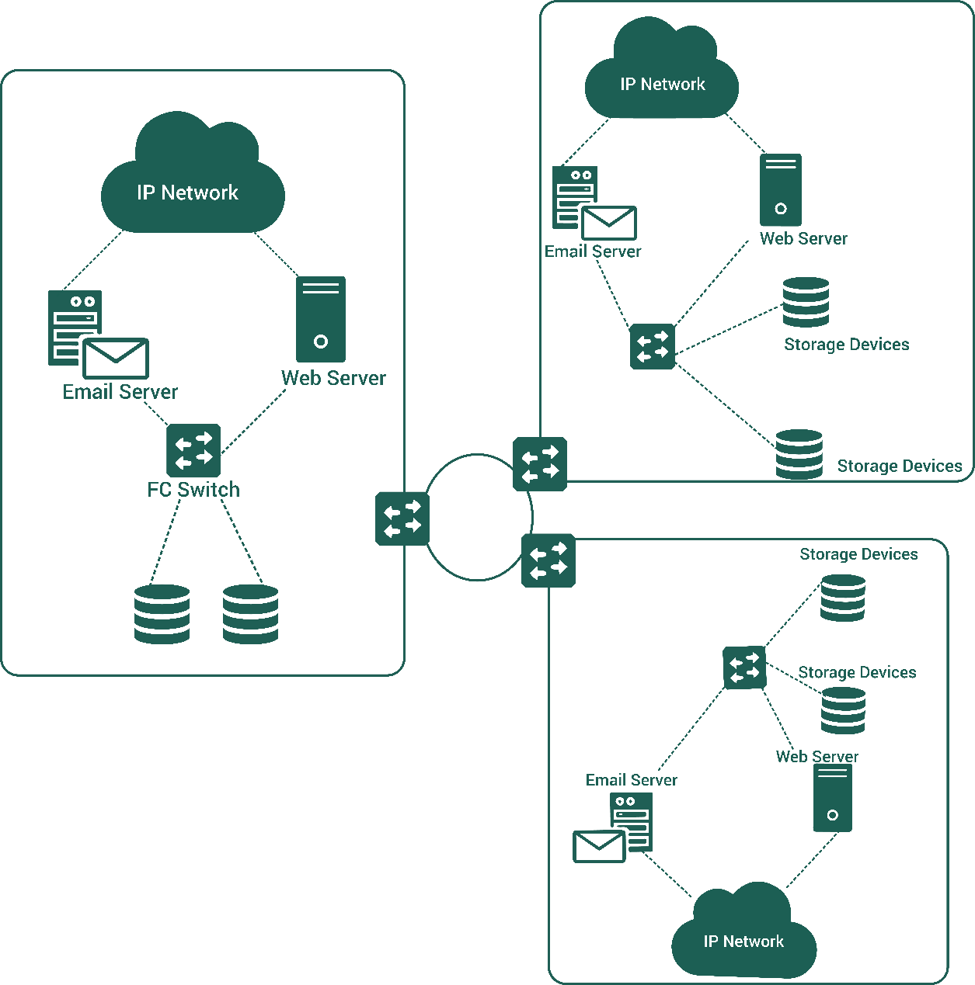
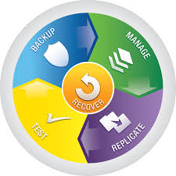
ServDR
Disaster Recovery Solution for IT Infrastructure
ServDR:
IT Infrastructure Disaster Recovery Framework
DR Assessment, Plans, Support and Review
Site replication solutions
Data backup, archival and restoration
DR Planning & Implementation for:
Core IT Infrastructure
Enterprise Applications
Enterprise data management
Enterprise Mailing Systems

Slide 14
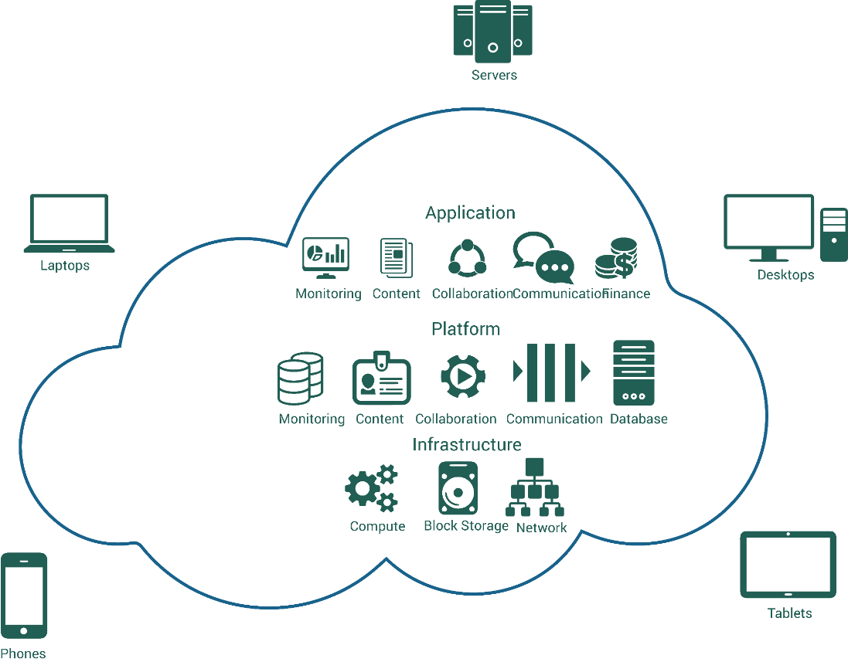
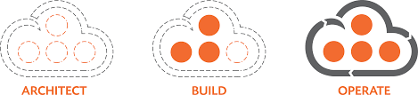
ServCloud
Dedicated Support for Cloud Services
ServCloud:
Cloud Ready Assessment and Solution Design
Build/Implement/Migrate/Provision on Public Cloud
Private Cloud on Public Cloud
Managed Services from NOC
Cloud Aggregation
CoE based support for Workloads on
Oracle / AWS / Azure / Soft layer /Rackspace
OpenStack based
Support for Dev. Ops
Moving right workloads to right Clouds
Private Cloud

Slide 15
Major Types of Migration
Migration Types:
Lift and Shift (Migrate the servers as-is to the destination DC)
Image based migration with tools (make the image of the server and build the new server with this image in the destination DC using the migration tool)
Application and Database migration (Copy the application directories and database. Build the application and restore the database to the new server)
Scenarios:
In-house Data Center to Public Cloud
In-house Data Center to Private Cloud
One Cloud to another cloud
Based on the scenario, the migration process/method will be varying.
There are three major ways the servers are being migrated based upon the existing/source infra and the destination cloud/Infrastructure

Slide 16
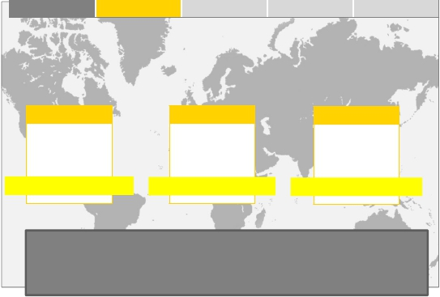
Techwave iMicron Cloud
Cloud Marketplace
A Globally integrated cloud marketplace providing infra services through global partners integrated across the world with remote managed services to manage the infrastructure. iMicron has seamless integration with over 10+ (and growing) world class global providers with DC’s spread over 9 countries .
.
► Techwave iMicron delivers cloud solutions for global enterprises. As a master cloud service provider, iMicron offers individual, start-up, enterprise and partner access to a unique multi-cloud global marketplace, along with solutions to build their infrastructure, expertise to enable and empower enterprises to provision, configure and manage cloud technologies with ease.
► Techwave iMicron operates as a single, integrated cloud services platform across geographies , giving clients access to additional range of compute configurations and empowers them to rapidly deploy compute resources wherever required across the globe to power the growth of their business with an unmatched uptime offered by the best of the service providers .
Global | iMicron allows clients- global reach at a click.
 | 10+ & growing CSP’s | 20+ DC’s | 900+ Config’s | 9+ Countries
Offices spread over 4 continents
USA , Canada
Europe
Asia
San Jose
Chicago
Toronto
London
Zurich
Prague
Singapore
Nasik
Some of DC locations across globe (partner CSP’s)
Our unmatched global reach and integrated partner model allows you to run your workloads without downtime and latency issues.

Slide 17
Techwave iMicron Value Proposition
Single Window Invoicing for Multiple Service Providers
Vendor Agnostic Advice & Environment
Access to more than 20 DC Locations
Access to 11+ Global Service providers
One window Multiple instance management
Multiple cloud Orchestration Options
Experienced Professionals ,with Support reliability
Consolidated Revenue outflow view across Partners
Best Configuration & Best price comparison at global level
Ease of switching across service providers

Slide 18



DevOps
AGILE Methodology
DevOps is a way to align people, processes, and technology to enable unified application delivery and increase business agility
People
End-to-end implementation
Strategy and vision workshops
Maturity assessments
Reference architecture
Process
Technology
Best practices: processes and methodologies
Process automation and workflows
Tools deployment and third-party integrations
Template and accelerators

Slide 19
DevOps Engagement Model
We take a collaborative approach to address the challenges faced by the organizations and ensure our client success through 'Continuous Planning', 'Continuous Integration' & 'Continuous Delivery'
Strategy for DevOps
DevOps Design
Establish DevOps
Ongoing Services
Continual Improvement
Phase – 1
Phase – 2
Phase – 3
Phase – 4
Assess the DevOps people, process, tools maturity
Implementing Demand Management and Financial Management Processes
Business Value Articulation for DevOps
Designing Capacity, Availability and Info-Sec Management Processes
Defining Organizational Structure for DevOps
Establishing SLAs & OLAs
Training & Onboarding DevOps Teams
Implementing Agile Methodology
Implementing Tools Required for DevOps
Defining Change, Release and Testing Processes
Implementing Incident, Problem, Knowledge and Event Management Processes
Establishing a Continual Improvement Framework

Slide 20
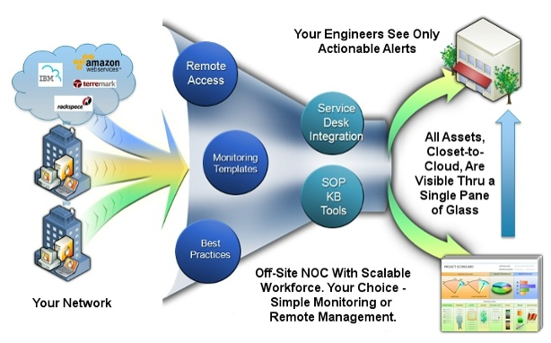
Case Study 1
Case study 1 : Premier Business School
Solution by Techwave : Data Center Assessment, Private Cloud Build and Implementation, Migration of Servers and Remote Infrastructure Management Services (Managed Services)
Value Props to Client :
Moved IT Ops from Capital expenditure to Operational expenditure model
Removed the dependencies of having man power onsite (this saved about 40% of their expenses)
No/reduced costs of Power, Fuel and Building Managed services
Reduced licensing costs by 25% (clustering and multi-tenant model)
Increased service levels by 15% and coverage by 25% (from 18 x 5 to 24 x 7 model)
Consolidation of servers (reduced underutilized servers)
50% cost reduction on Backup/Disaster recovery activities
Implemented Software defined environment for greater efficiency in utilizing resources (compute, storage and memory)
Removed all the single point failures

Slide 21
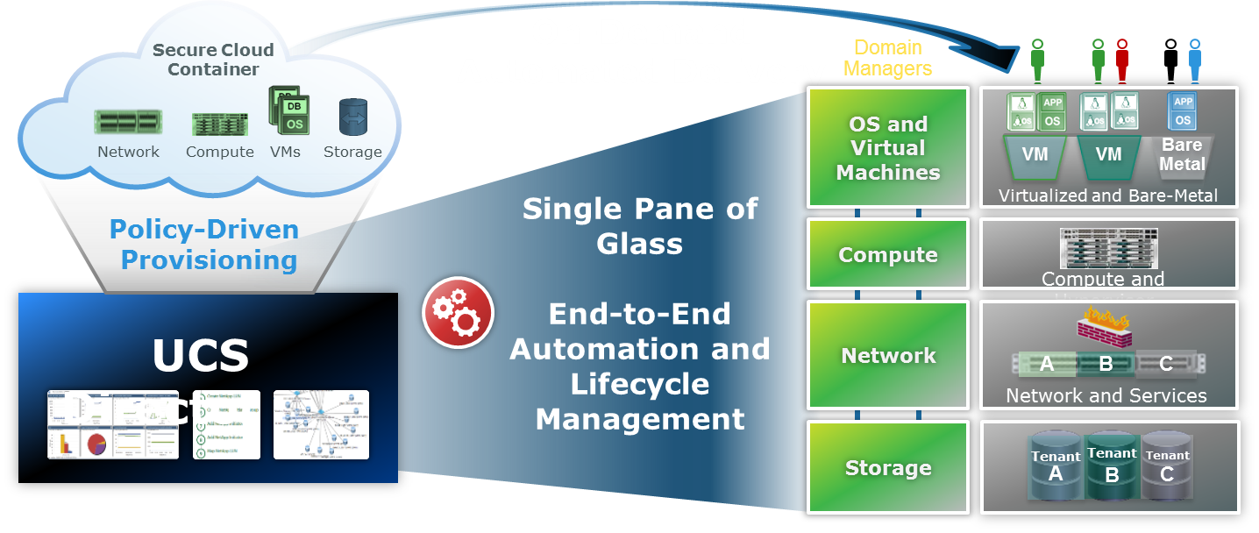
Case Study 2
Case study 2 : Hi-Tech Industry Major in Europe
Solution by Techwave : Remote Infrastructure Management and Managed Services
Value Props to Client :
Reduced the unwanted workloads (incidents and alerts from data center) by 60 %
80% reduction of onsite resources helped in reducing 45% costs
Automated the server building and patching activities
30% increase in service coverage
SLAs increased by 20%
Improved change and incident management process
Built and streamlined knowledge base
Introduced risk management process

Slide 22

Our Contacts
Address
Online
Abu Dhabi Office # 45, 19th Floor,
Al Ghaith Tower, Hamdan Street,
Abu Dhabi – UAE
E-Fax: 1-484-872-1458
Singapore 1 Scotts Road, Shaw center Singapore – 228208
Phone: 1-484-870-4854
www.techwave.net
/techwave-consulting-inc
/techwavec
Germany
Potsdamer Platz 1 10785 Berlin, Germany
Phone: +49 30 220 122 218
/Techwave-Consulting-Inc
London
Lakeside House, 1 Furzeground Way Stockley Park,
Uxbridge Middlesex, UB11 1BD,
United Kingdom
Phone: +44 (0) 2086 233 011
info@techwave.net
Saudi Arabia Office Number 711,
101 Business Tower,
King Abdulaziz Street, Saudi Arabia.
Fax: 1-484-872-1458
Netherlands
High Tech Campus 9, Eindhoven, Netherlands
Phone: +31 040 851 5290
Australia
Level 2, 2A Cambridge St Box Hill,
Victoria, Australia 3128.
Phone: +61 3 9898 6666

Slide 23
Thank You

